Slide 1
Decision Tree

Slide 2
Just like if else ladder

Slide 3
Binary Decision Tree

Slide 4
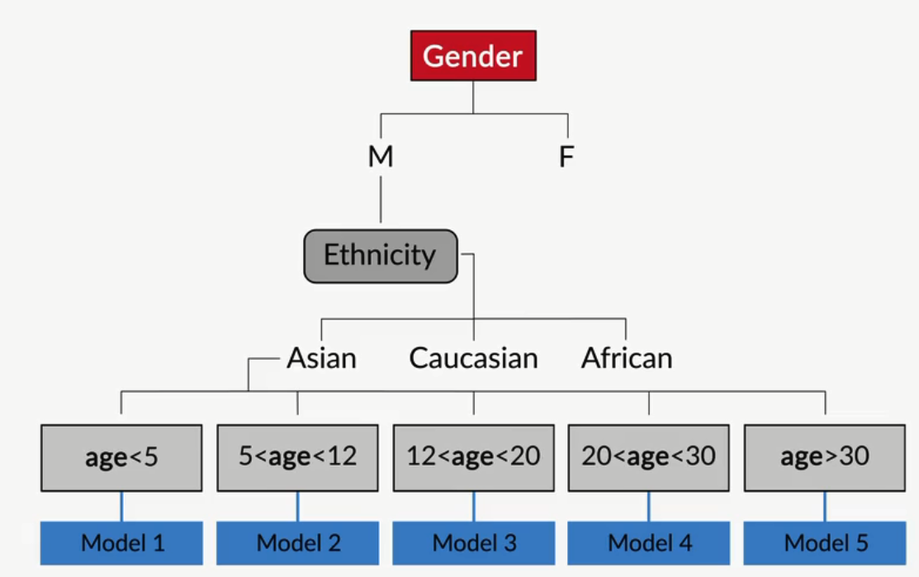
Regression with Decision Trees
Leaf contains the model

Slide 5
Homogeneity
completely homogeneous : Since all the data points belong to only one label, the data set is completely homogeneous
Homogeneity on particular split is the main concern and homogeneity must be always high in individual levels
There are different homogeneity measures
Split the data until leaf node has maximum homogeneity

Slide 6
So decision of weather to split further or not depends on homogeneity of leaf node

Slide 7
Homogeneity measures
Gini Index
Entropy
Information Gain

Slide 8
Numerically solve Gini

Slide 9
Gini Split / Gini IndexFavors larger partitions. Very simple to implement ----------.CART
Information Gain / EntropyFavors partitions that have small counts but many distinct values ------------------ ID3 / C4.5

Slide 10
Numerically solve entropy / Information Gain
Gini is minimum when entropy is maximum

Slide 11
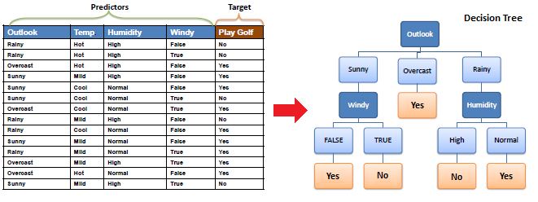
Solve for entropy

Slide 12
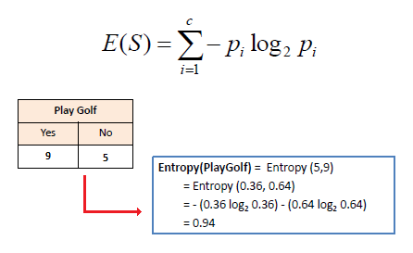

Slide 13
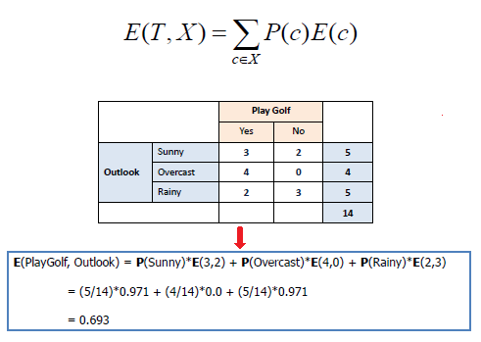

Slide 14
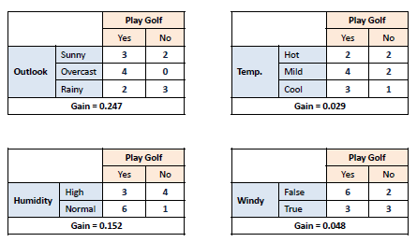

Slide 15
Note : If categorical variable you will do splitting based on measures , But if the case is continuous
Solution : R^2
So calculate R^2 before split and after split.
Higher the R^2 better the regression model

Slide 16
Advantages & Disadvantages
Advantages :
Predictions made by a decision tree are easily interpretable.
A decision tree does not assume anything specific about the nature of the attributes in a data set. It can seamlessly handle all kinds of data — numeric, categorical, strings, Boolean, and so on.
It does not require normalisation since it has to only compare the values within an attribute.
Decision trees often give us an idea of the relative importance of the explanatory attributes that are used for prediction.

Slide 17
Disadvantages :
-> overfit the data

Slide 18
Control the tree
Truncating : stop the tree while growing
Pruning : cut the tree after it is grown

Slide 19
Truncating
Limit the minimum size of partition after split
Minimise measure of homogeneity
Limit depth of tree
Set minimum threshold on number of samples that appear on leaf
Set limit on maximum leaf in a tree

Slide 20
Try
help(DecisionTreeClassifier)

Slide 21
Pruning
Reduced error pruning
Take a tree and try pruning on combining individual leaves

Slide 22
Steps to build a Decision Tree model
Read the data
Clean the data
Type conversion ( dummy / one hot encoding or label encoding)
Apply the model
Validate
Select hyper parameters
Tuning or pruning
Re-build model
Validate

Slide 23
Hyper Parameters in Decision Tree

